Slide 1

University Institute of Engineering
DEPARTMENT – AU1- AU5
Bachelor of Engineering
Subject Name: Mathematics-II
Subject Code: 23SMT-125
DISCOVER . LEARN . EMPOWER

Slide 2
COURSE OUTCOMES
Will be covered in this lecture
CO Number | Title | Level
CO1 | Remember the concepts based upon partial differentiation, multiple integrals and vector calculus. | Remember
CO2 | Understand the concepts of the partial differentiation, multiple integrals and vector calculus. | Understand
CO3 | Apply concepts of partial differentiation, multiple integrals and vector calculus and to use in practical problems. | Apply
CO4 | Analyze concepts of partial differentiation, multiple integrals and vector calculus and its application of analysis to Engineering problems. | Analyze
CO5 | Create the solution for real problems based upon partial differentiation, multiple integrals and vector calculus. | Applications

Slide 3
Introduction
If f is a function of two variables x and y, suppose we let only x vary while keeping y fixed, say y = b, where b is a constant.
Then we are really considering a function of a single variable x, namely, g(x) = f(x, b).
If g has a derivative at a, then we call it the partial derivative of f with respect to x at (a, b) and denote it by f_{x}(a, b).

Slide 4
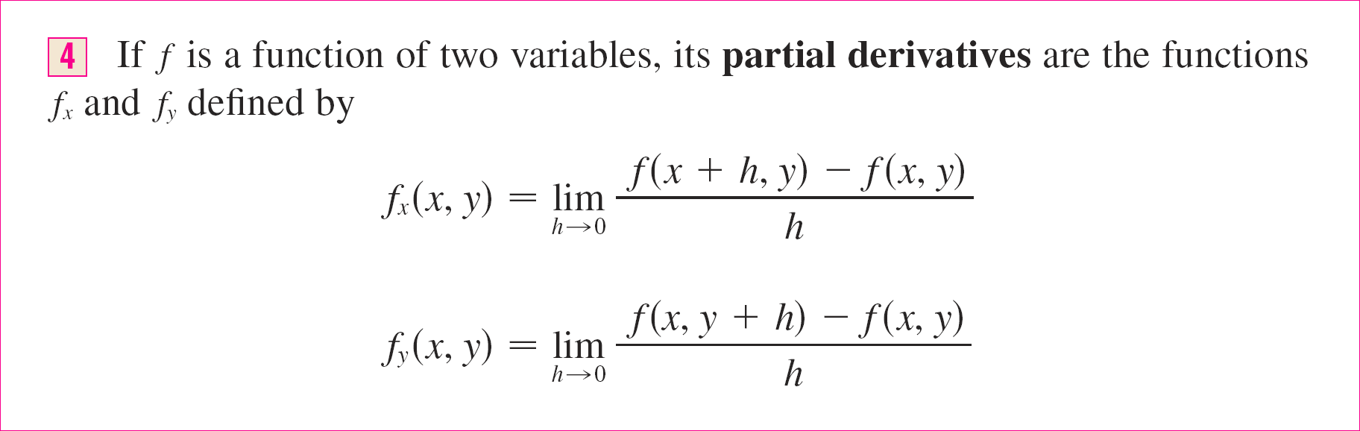
Definition
If we now let the point (a, b) vary, f_{x} and f_{y} become functions of two variables:

Slide 5
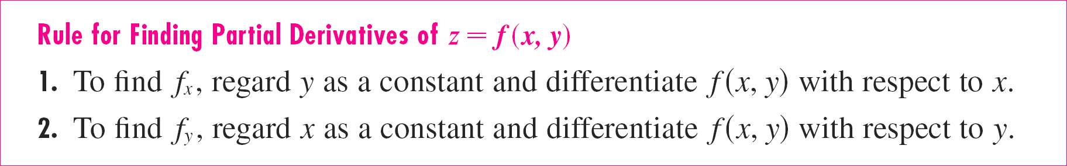
Finding Partial Derivatives
The partial derivative with respect to x is just the ordinary derivative of the function g of a single variable that we get by keeping y fixed:

Slide 6
Example
If f(x, y) = x³ + x²y³ – 2y², find f_{x}(2, 1) and f_{y}(2, 1).
Solution Holding y constant and differentiating with respect to x, we get
f_{x}(x, y) = 3x² + 2xy³
and so
f_{x}(2, 1) = 3 · 2² + 2 · 2 · 1³ = 16

Slide 7
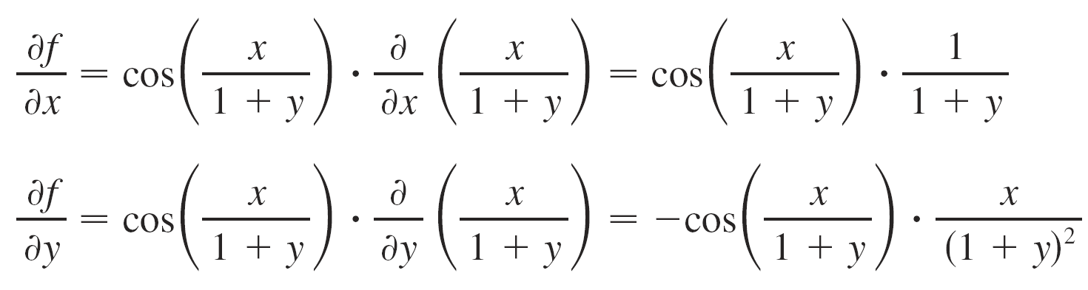
Example
If
Solution Using the Chain Rule for functions of one variable, we have

Slide 8
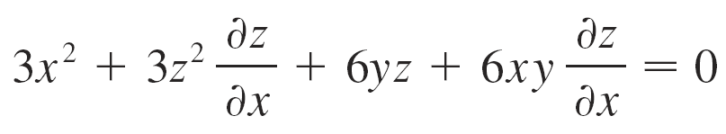
Example
Find ∂z/∂x and ∂z/∂y if z is defined implicitly as a function of x and y by
x³ + y³ + z³ + 6xyz = 1
Solution To find ∂z/∂x, we differentiate implicitly with respect to x, being careful to treat y as a constant:

Slide 9
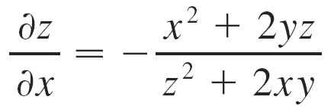
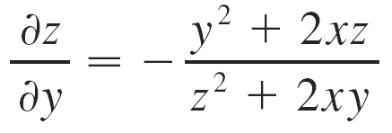
Solution (cont’d)
Solving this equation for ∂z/∂x, we obtain
Similarly, implicit differentiation with respect to y gives

Slide 10
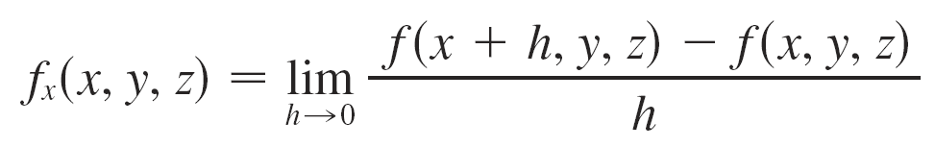
More Than Two Variables
Partial derivatives can also be defined for functions of three or more variables, for example
If w = f(x, y, z), then f_{x} = ∂w/∂x is the rate of change of w with respect to x when y and z are held fixed.

Slide 11
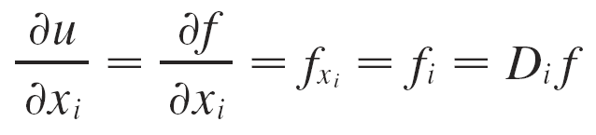
More Than Two Variables (cont’d)
But we can’t interpret f_{x} geometrically because the graph of f lies in four-dimensional space.
In general, if u = f(x₁, x₂ ,…, x_{n}), then
and we also write

Slide 12
Example
Find f_{x} , f_{y} , and f_{z} if f(x, y, z) = e^{xy} ln z.
Solution Holding y and z constant and differentiating with respect to x, we have
f_{x} = ye^{xy} ln z
Similarly,
f_{y} = xe^{xy} ln z and f_{z} = e^{xy}/z

Slide 13
Higher Derivatives
If f is a function of two variables, then its partial derivatives f_{x} and f_{y} are also functions of two variables, so we can consider their partial derivatives
(f_{x})_{x} , (f_{x})_{y} , (f_{y})_{x} , and (f_{y})_{y} ,
which are called the second partial derivatives of f.

Slide 14
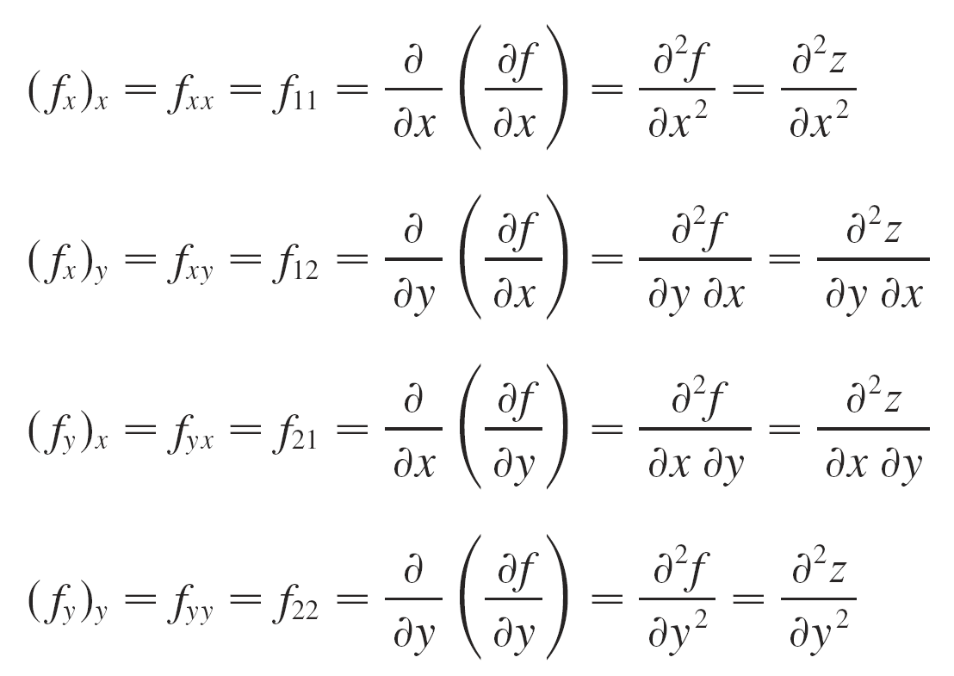
Higher Derivatives (cont’d)
If z = f(x, y), we use the following notation:

Slide 15
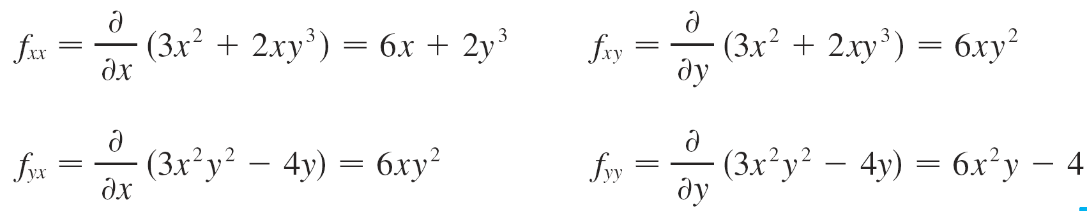
Example
Find the second partial derivatives of
f(x, y) = x³ + x²y³ – 2y²
Solution Earlier we found that
f_{x}(x, y) = 3x² + 2xy³ f_{y}(x, y) = 3x²y² – 4y
Therefore

Slide 16
Homogeneous Function
A function f(x₁,x₂,…x_{n}) is said to be homogeneous of degree k if
f(tx₁,tx₂,…tx_{n}) = t^{k} f(x₁,x₂,…x_{n})
when a function is homogeneous of degree one, a doubling of all of its arguments doubles the value of the function itself
when a function is homogeneous of degree zero, a doubling of all of its arguments leaves the value of the function unchanged

Slide 17
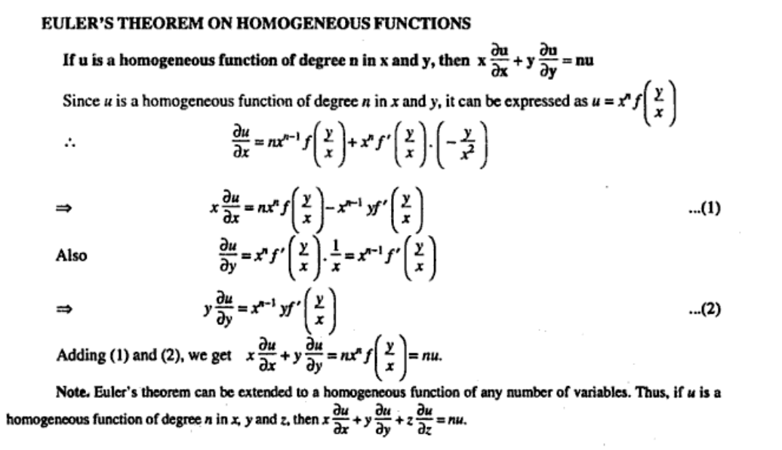

Slide 18
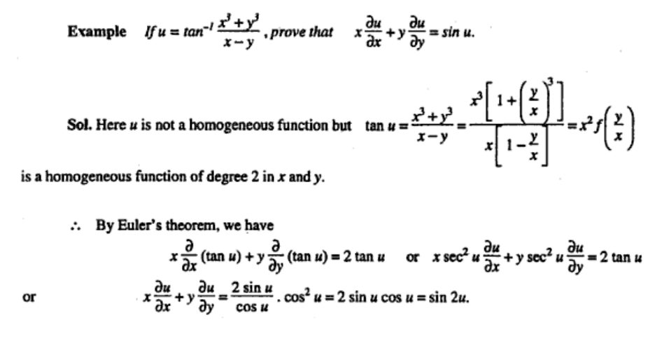

Slide 19
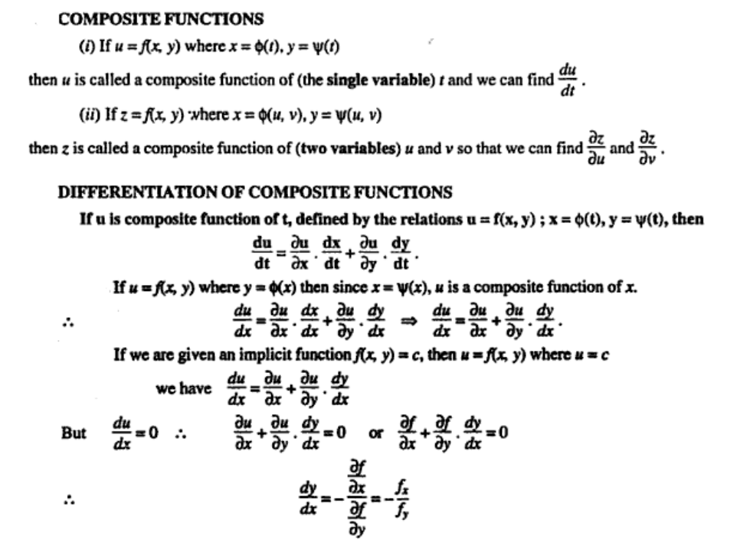

Slide 20
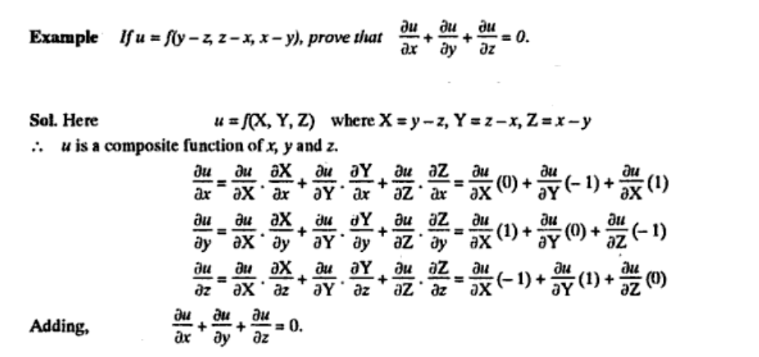

Slide 21
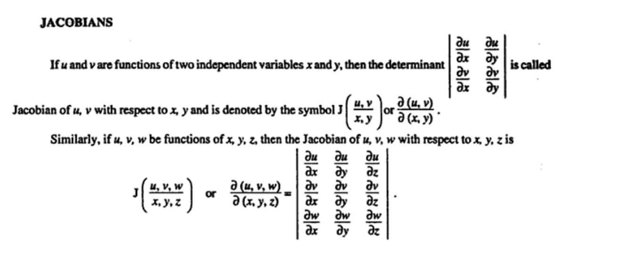

Slide 22
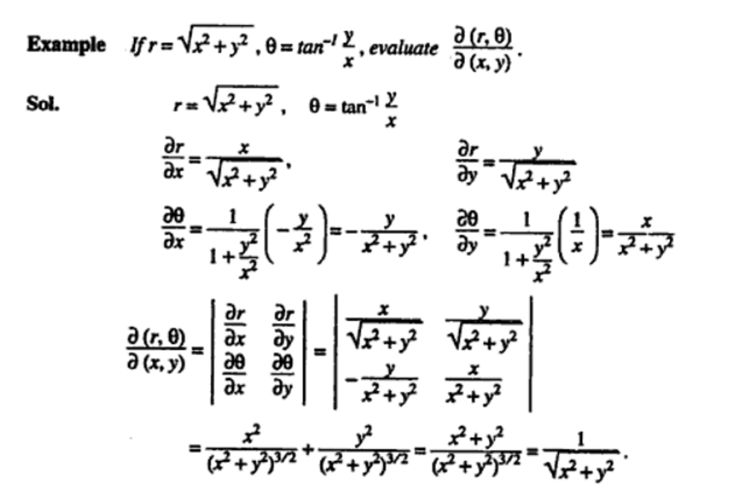

Slide 23
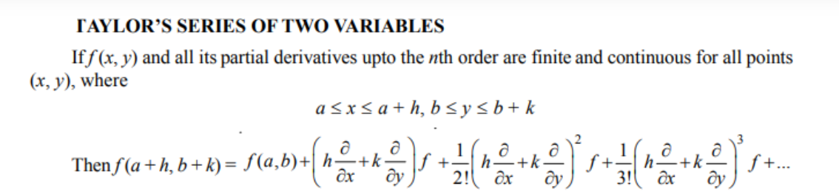

Slide 24
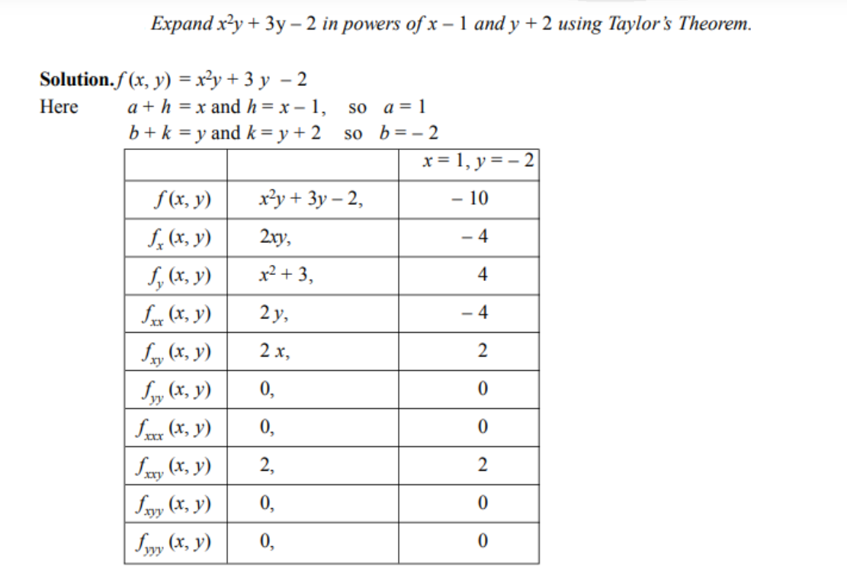

Slide 25
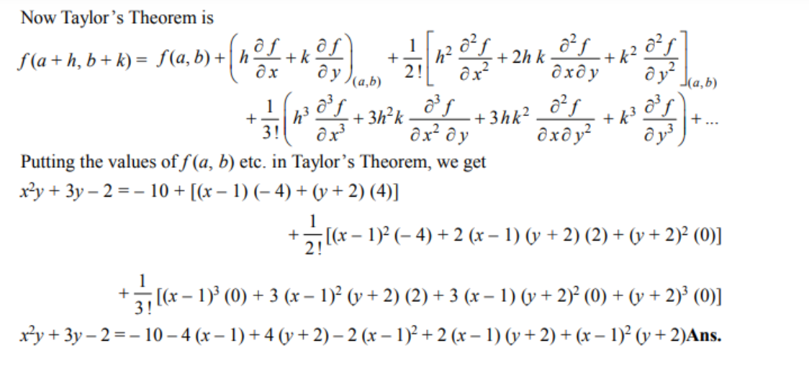

Slide 26
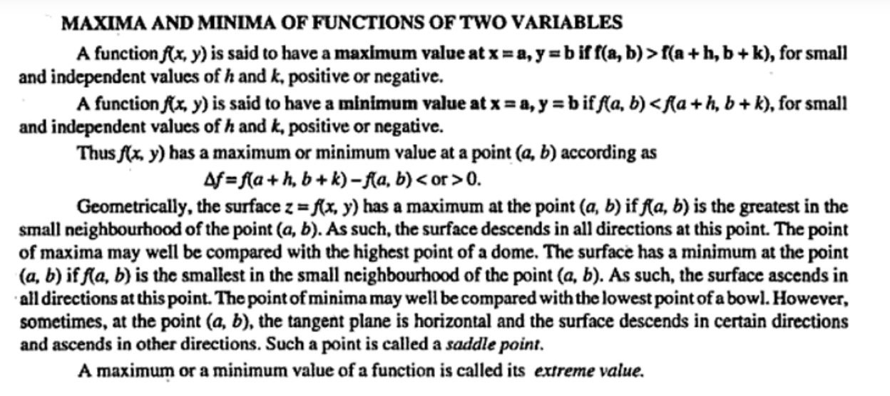

Slide 27
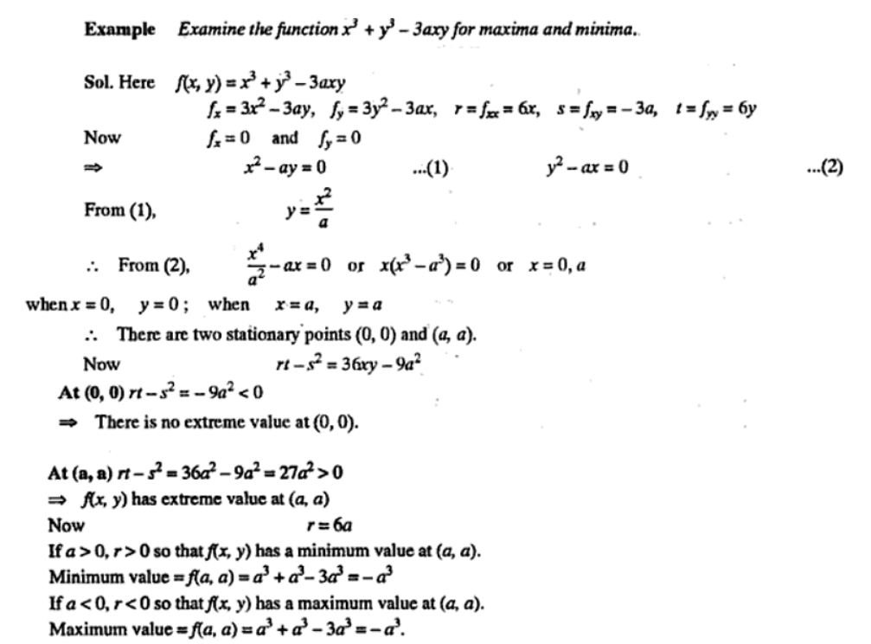

Slide 28
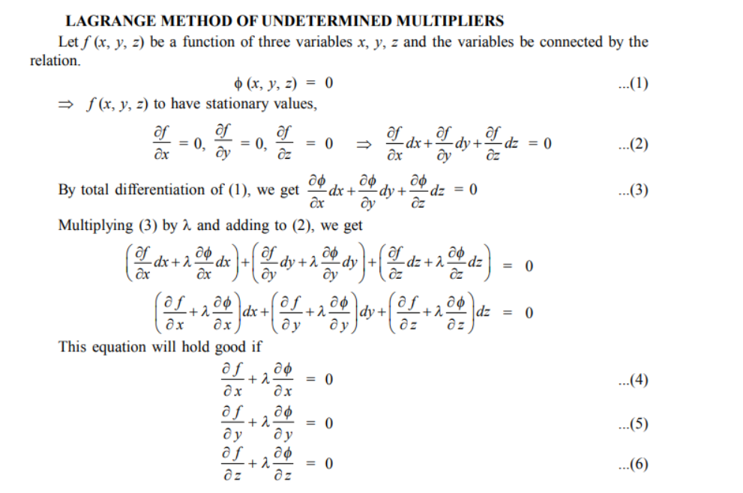

Slide 29
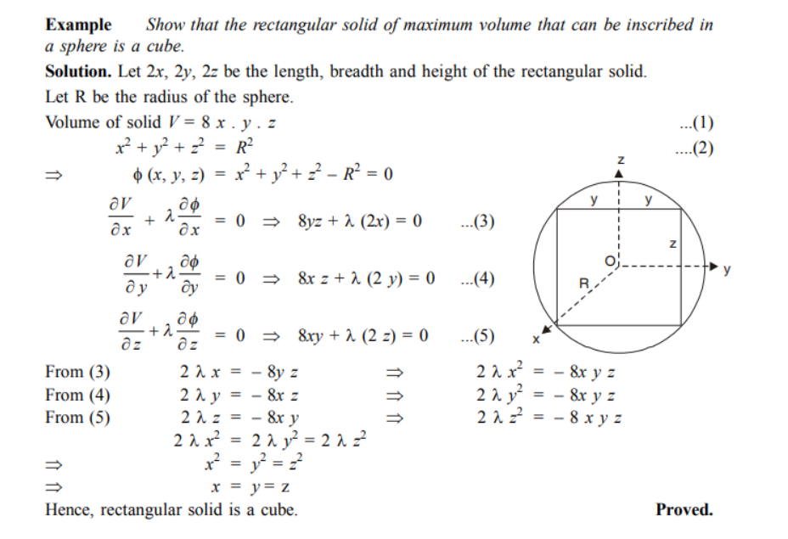

Slide 30
REFERENCES
TEXTBOOKS:
1. E. Kreyszig, Advanced Engineering Mathematics, John Wiley,10th Ed.2011., New Delhi
2. H.K. Dass, Higher Engineering Mathematics, S Chand Publishers, 3rd revised edition, 2014.
3. R.K. Jain, and S.R.K. Iyengar, Advanced Engineering Mathematics, 3rd Edition, Narosa Publishing House, 2004, New Delhi.
Reference Material:
1. B.V. Ramana Advanced Engineering Mathematics, McGraw Hill, July 2006, New Delhi.
2. B. Thomas and, R.L., Finney, Calculus and Analytic Geometry, Pearson Education, 11thEdition.
3. N.P. Bali and Manish Goyal, Atextbook of Engineering Mathematics, Laxmi Publications, Reprint, 2008
Suggestive Readings :
A Textbook Of Engineering Mathematics (PTU, Jalandhar) Sem-II by Usha Paul N. P. Bali (z-lib.org).pdf
E. Kreyszig, Advanced Engineering Mathematics, John Wiley,10th Ed.2011., New Delhi - Bing
R.K. Jain, and S.R.K. Iyengar, Advanced Engineering Mathematics, 3rd Edition, Narosa Publishing House, 2004, New Delhi - Bing
B.V. Ramana Advanced Engineering Mathematics, McGraw Hill, July 2006, New Delhi. - Bing
A Textbook Of Engineering Mathematics (PTU, Jalandhar) Sem-II by Usha Paul N. P. Bali (z-lib.org).pdf
B. Thomas and, R.L., Finney, Calculus and Analytic Geometry, Pearson Education, 11th Edition - Bing

Slide 31
THANK YOU

